Slide 1

Walmart Transaction Fraud Detection System Domain: Marketing & Business
FIRST REVIEW
Course Code: CS6510
Course Title: Project 1
Register Number:23MSP3032
Name:DHINESH.S.P
Date:28.11.23

Slide 2
PROBLEM STATEMENT
This study aims to develop a robust machine learning model to predict Walmart’s fraud transaction.
Walmart faces challenges associated with transaction fraud, where malicious actors attempt to make unauthorized or deceitful purchases. Fraudulent transactions can lead to financial losses for both Walmart and its customers, damage to the company's reputation, and potential legal issues. The task is to create a system that can effectively distinguish between legitimate and fraudulent transactions, providing a secure shopping experience for customers

Slide 3
OBJECTIVES
Walmart's fraud detection system uses real-time monitoring to quickly react and minimize financial losses, with the goal of achieving a high degree of accuracy in recognizing and stopping fraudulent activity.
The system places a high priority on its capacity to adjust to new threats and keep ahead of evolving fraud strategies. One of the main goals is scalability, which allows the system to easily manage high transaction volumes.
Furthermore, the solution aims to reduce interference for reputable clients by offering thorough protection against different types of fraud and facilitating a smooth integration with payment gateways.

Slide 4
DATASET
Source of the Dataset: Walmart fraud detection (kaggle.com)
No. of Observations:6362604
Column/Feature Details:
Store: The identifier of the Walmart store.
Date: The date on which the recorded data pertains.
Temperature: The temperature on the given date, likely in degrees Fahrenheit.
Fuel_Price: The cost of fuel, potentially influencing transportation and logistics.
MarkDown1 - MarkDown5: These columns represent different types of promotional markdowns. The exact nature of each markdown type isn't specified in the data.
CPI: The Consumer Price Index, indicating the average price level for goods and services.
Unemployment: The unemployment rate at the time the data was recorded.
IsHoliday: A boolean indicating whether the date

Slide 5
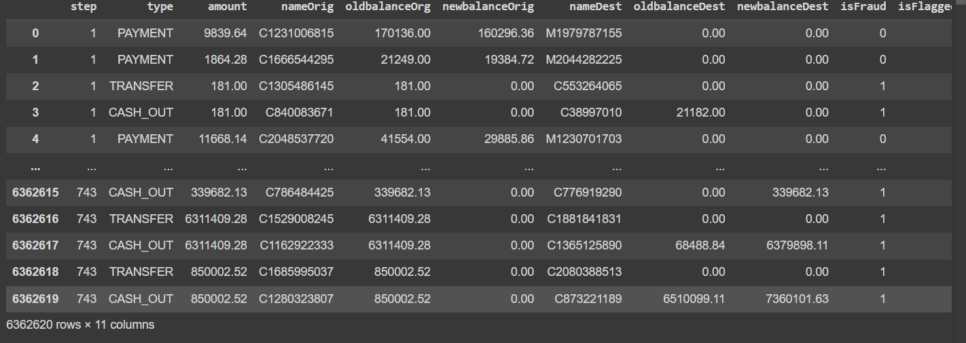
SCREENSHOT OF DATASET

Slide 6
Review of Related Literature
Base Paper: Dr. C. Shyamala, P. Sabarish, T. Vignesh, S. Yogeendran. 2021 WALMART Fraud Detection using MACHINE LEARNING ALGORITHMS. , K.Ramakrishnan College of Technology Retrieved from Semantic Scholar
Methodology used:AutoML framework with various tools like automated feature engineering
Outcomes:Eases creation and maintenance of MLmodels
Point taken into consideration for your methodology:
Could focus on enhancing crossdomain adaptability, improving data security, and integrating real-time adaptation algorithms for dynamic market responsiveness.

Slide 7
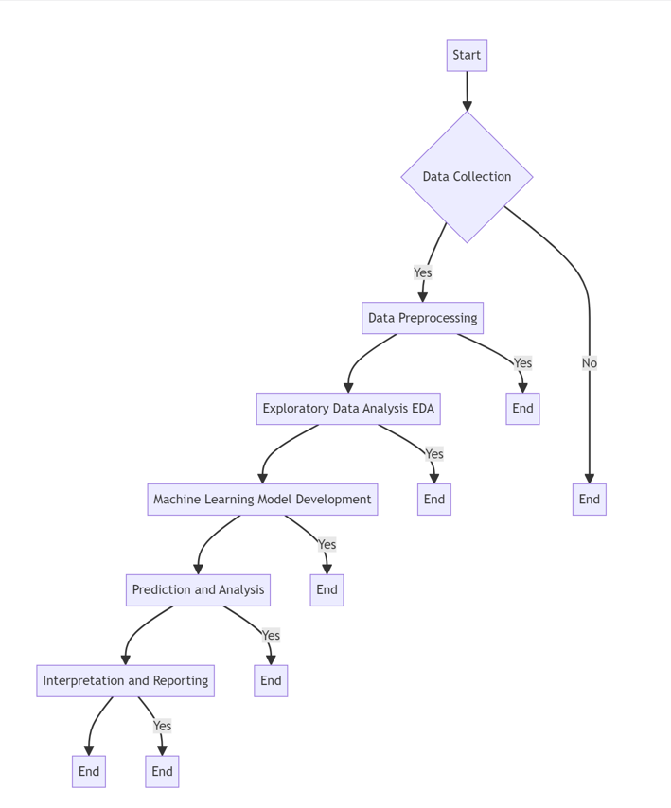
PROPOSED METHODOLOGY
ARCHITECTURE DIAGRAM

Slide 8
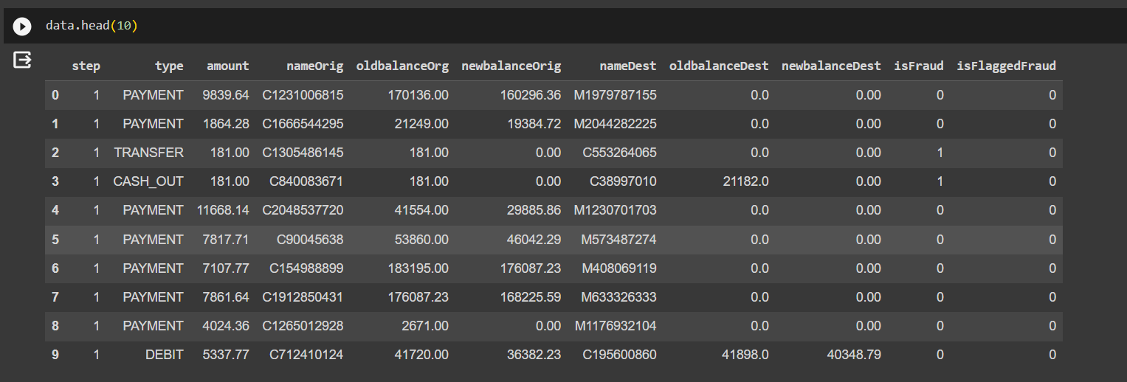
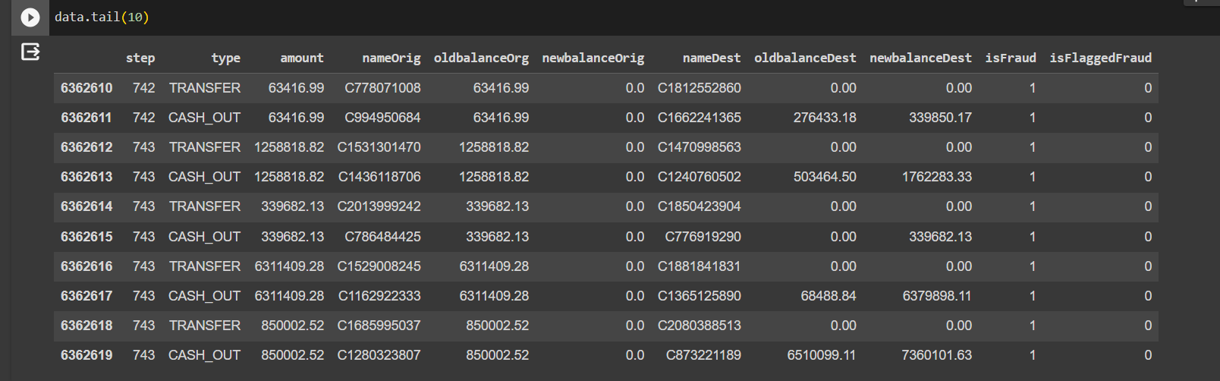
Exploratory Data Analysis

Slide 9
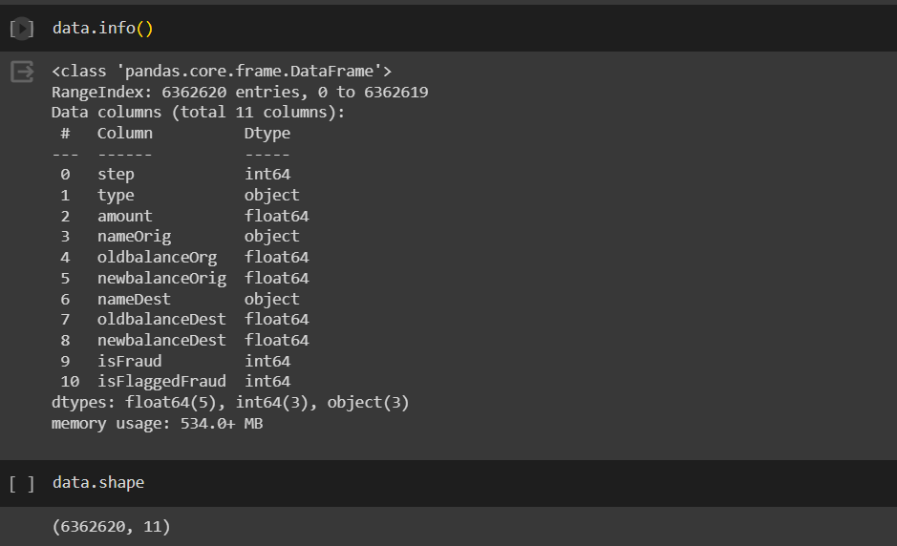
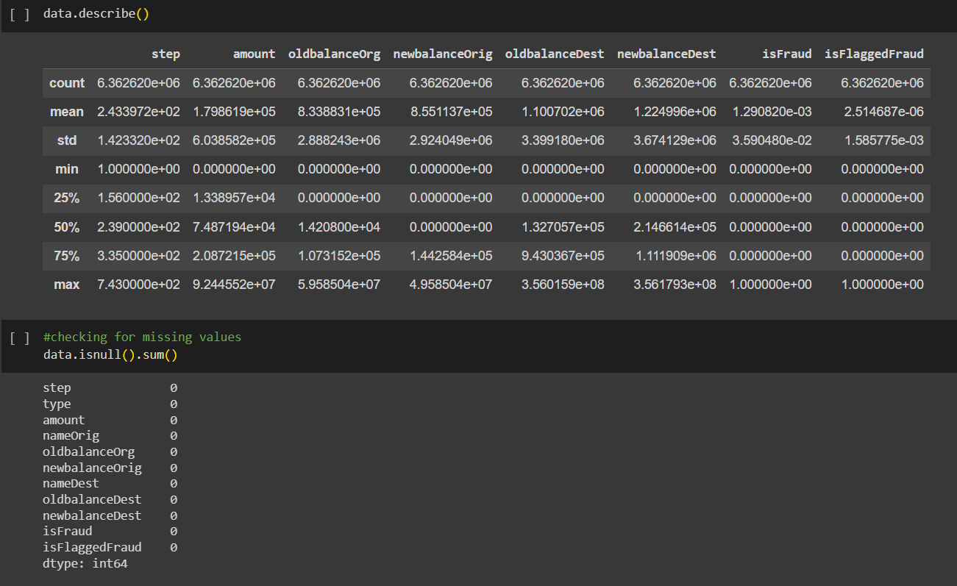

Slide 10

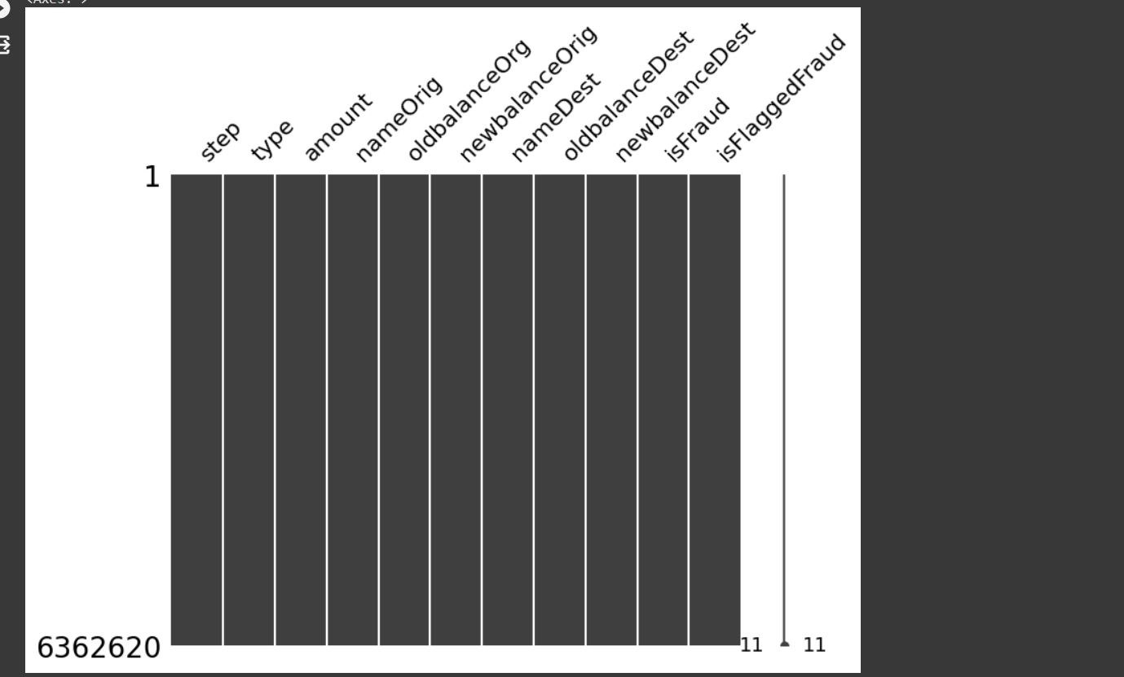

Slide 11
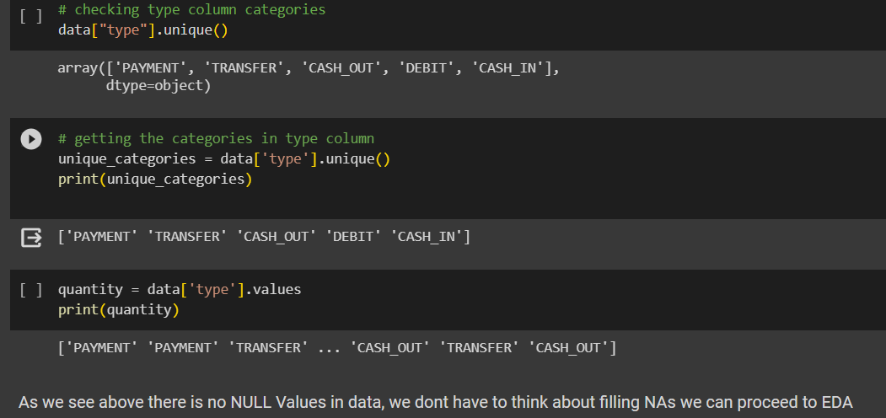
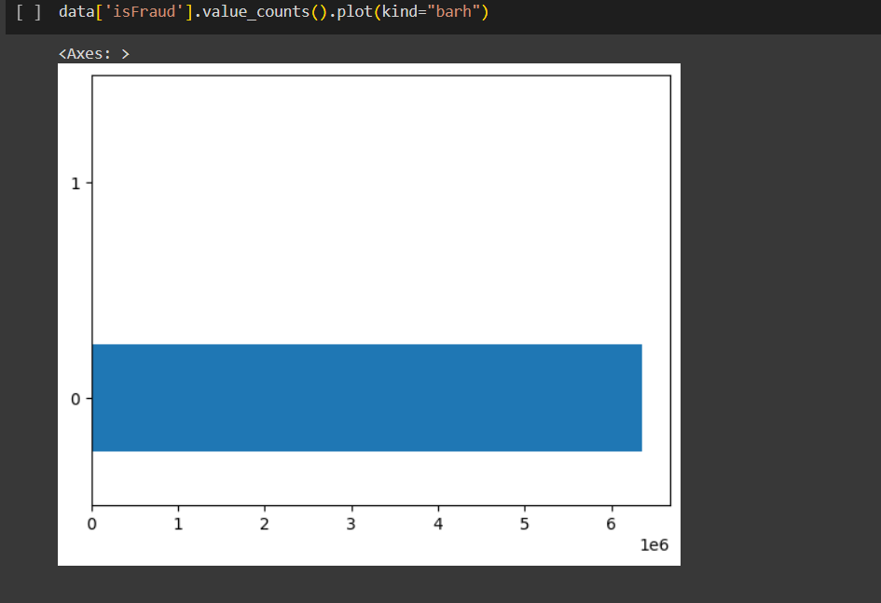

Slide 12
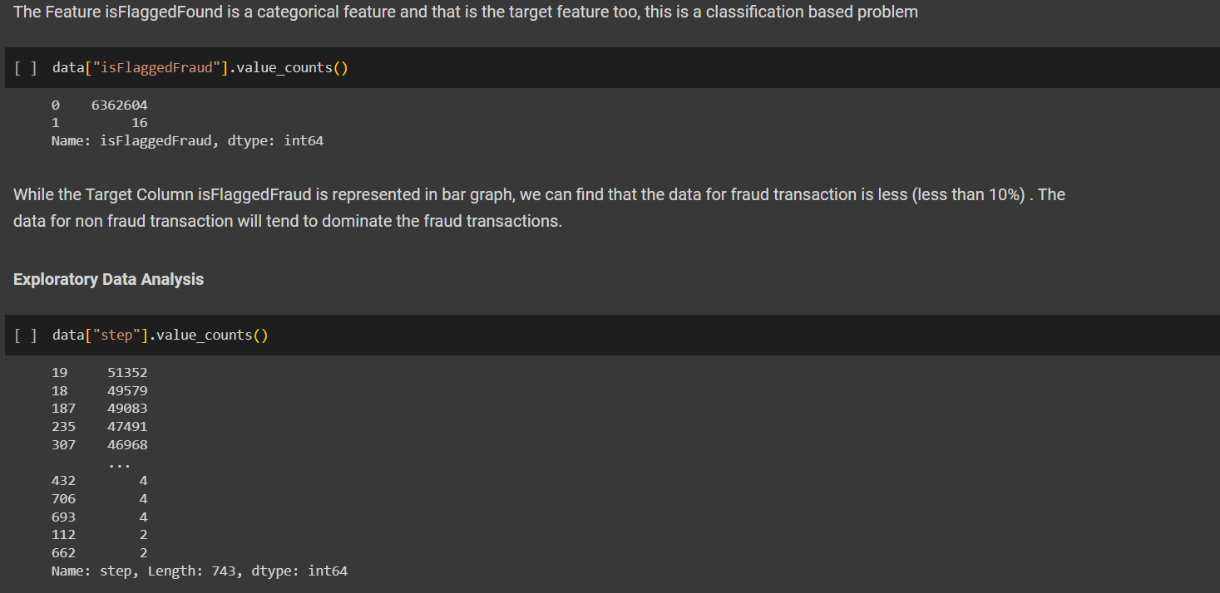

Slide 13
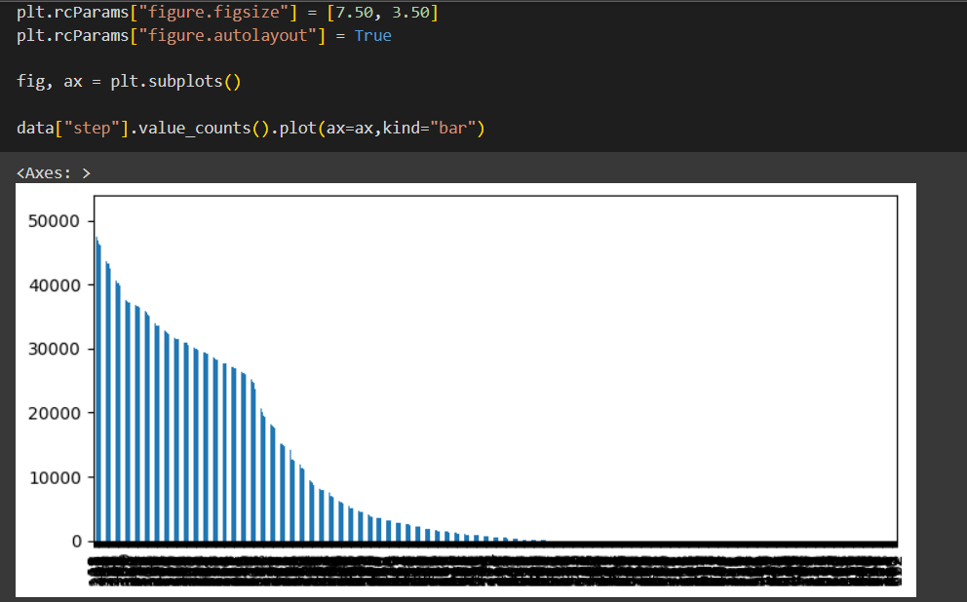

Slide 14
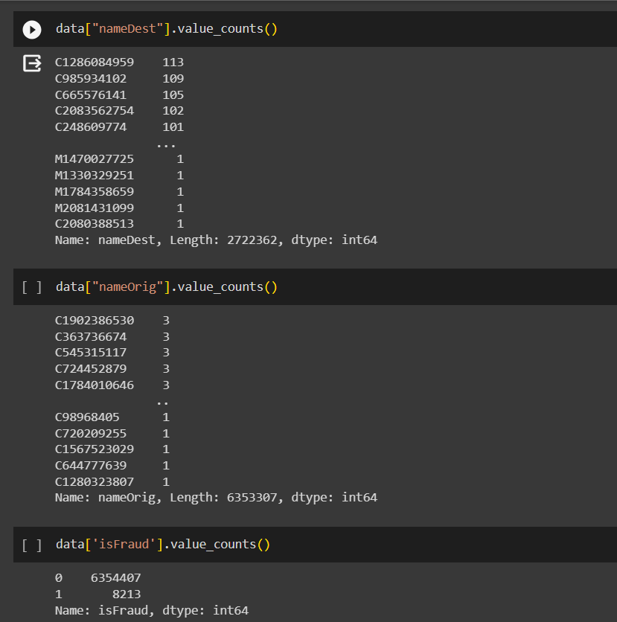

Slide 15
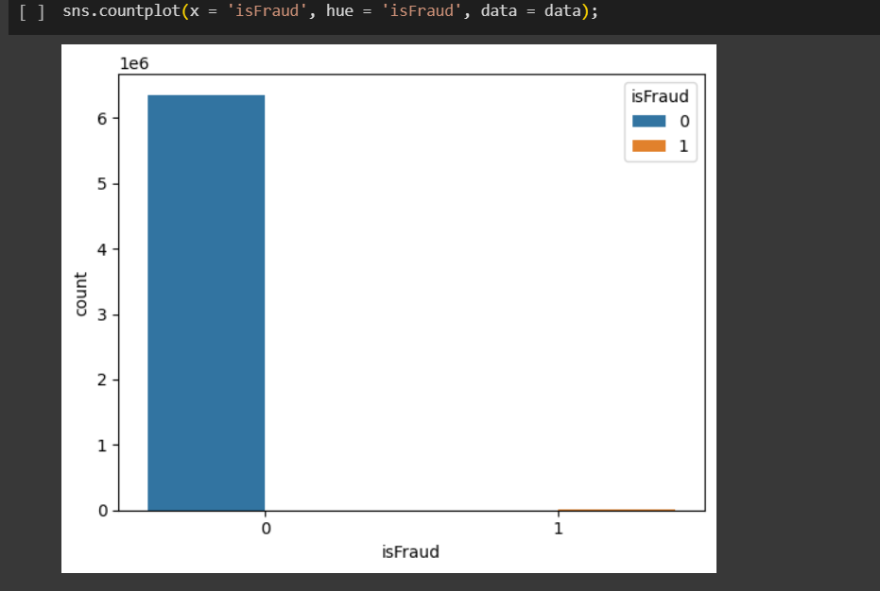
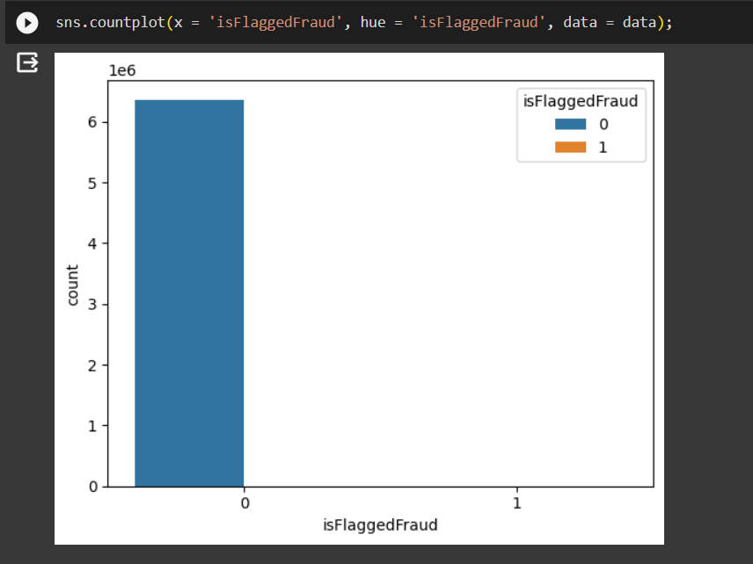

Slide 16
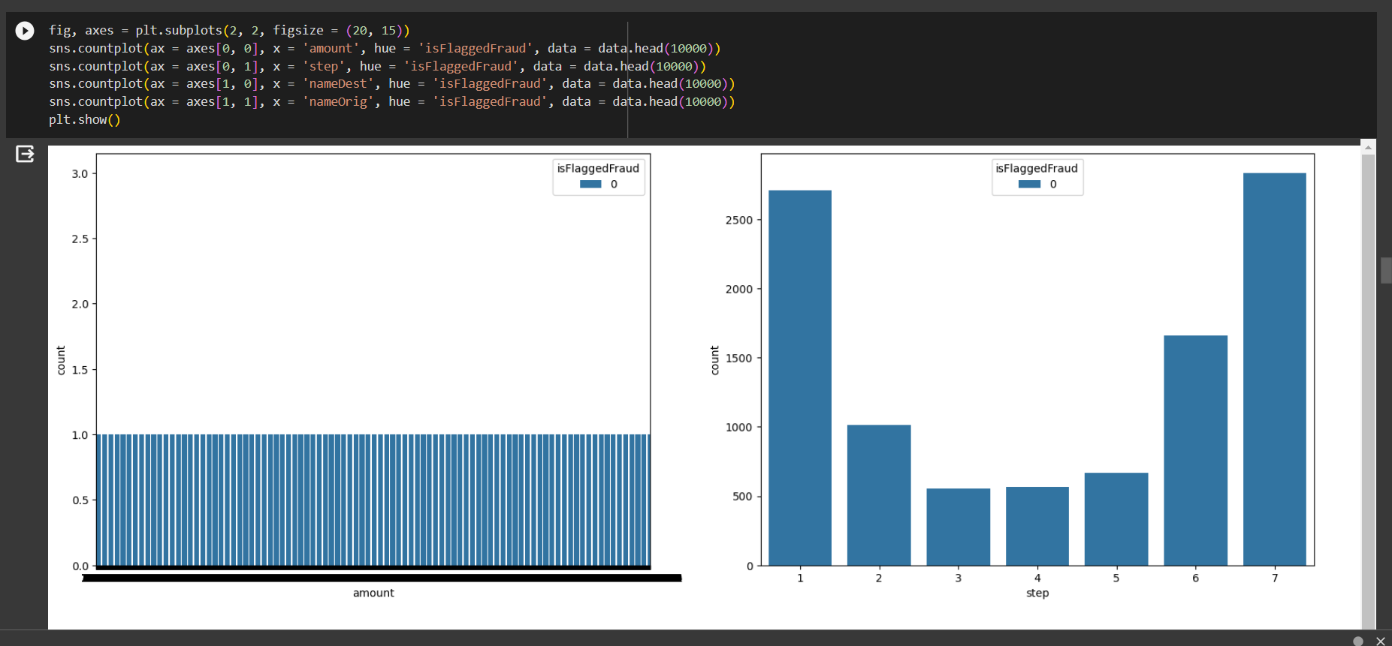

Slide 17
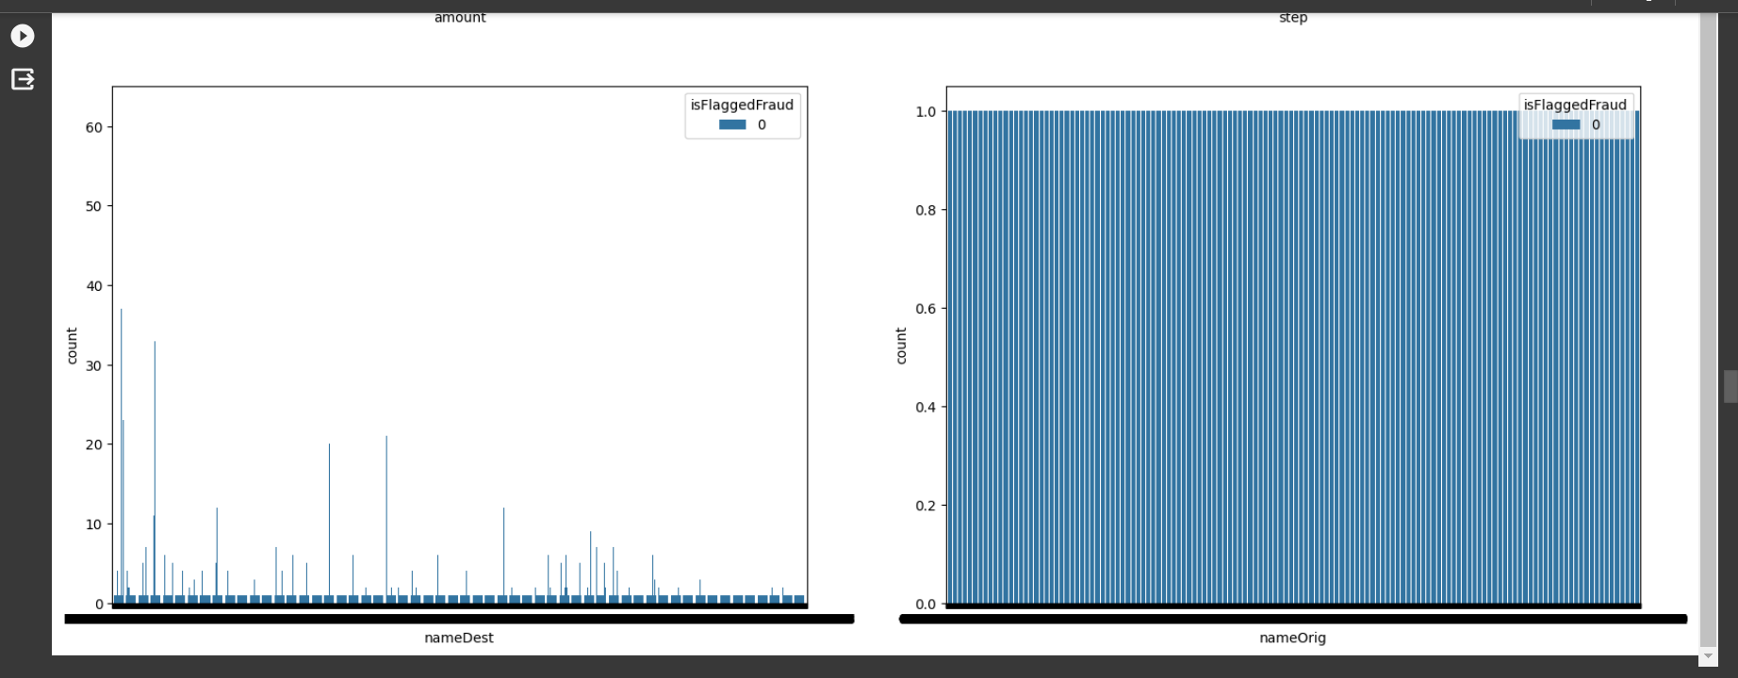

Slide 18
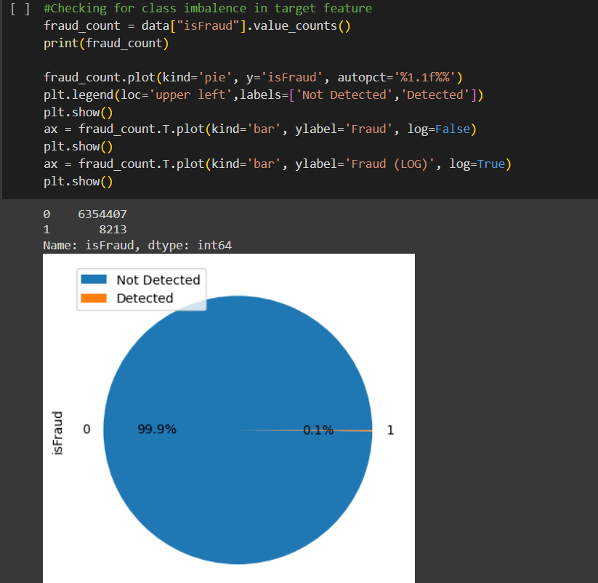

Slide 19
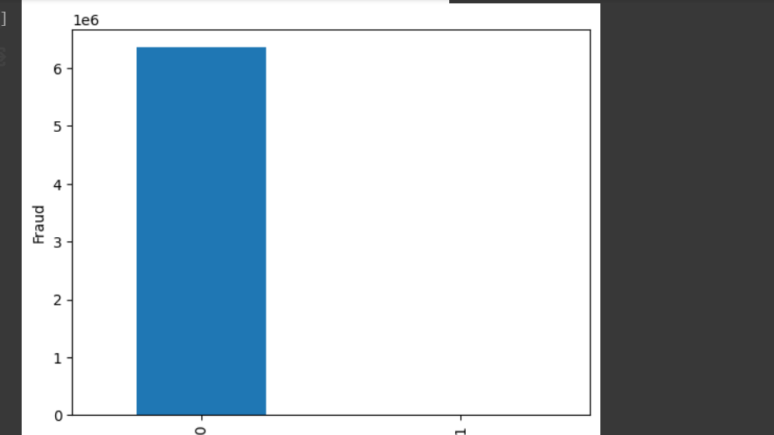
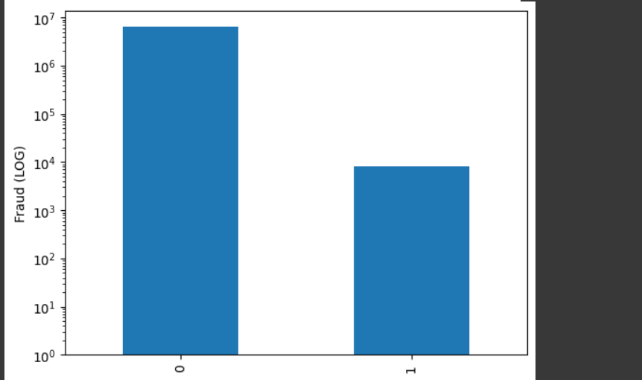

Slide 20
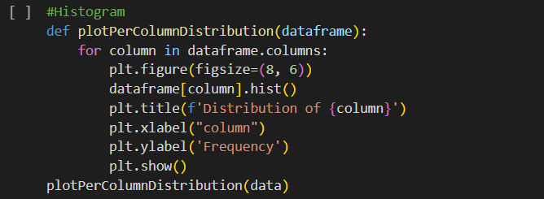
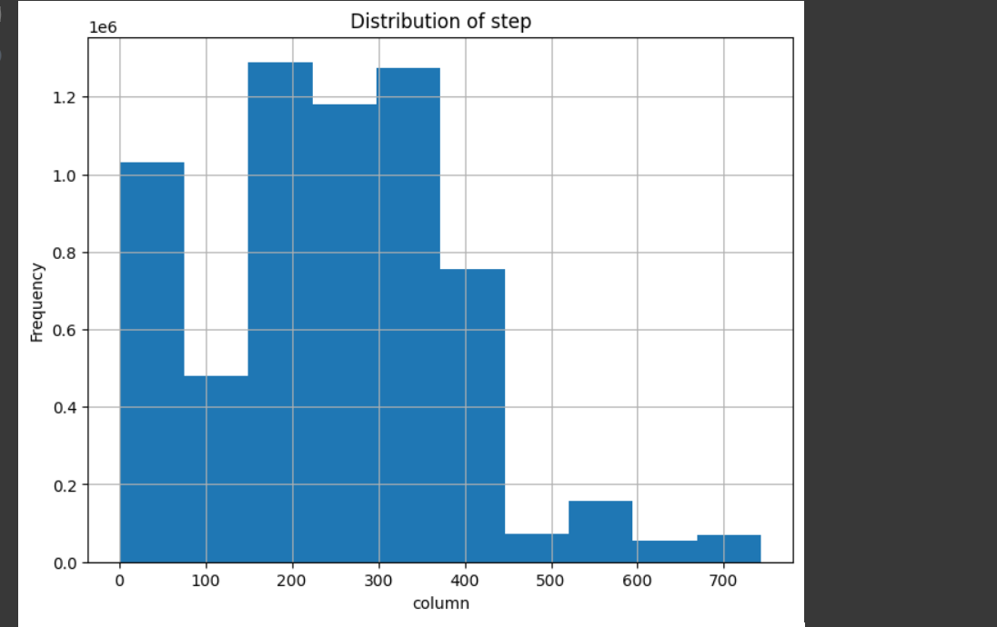

Slide 21
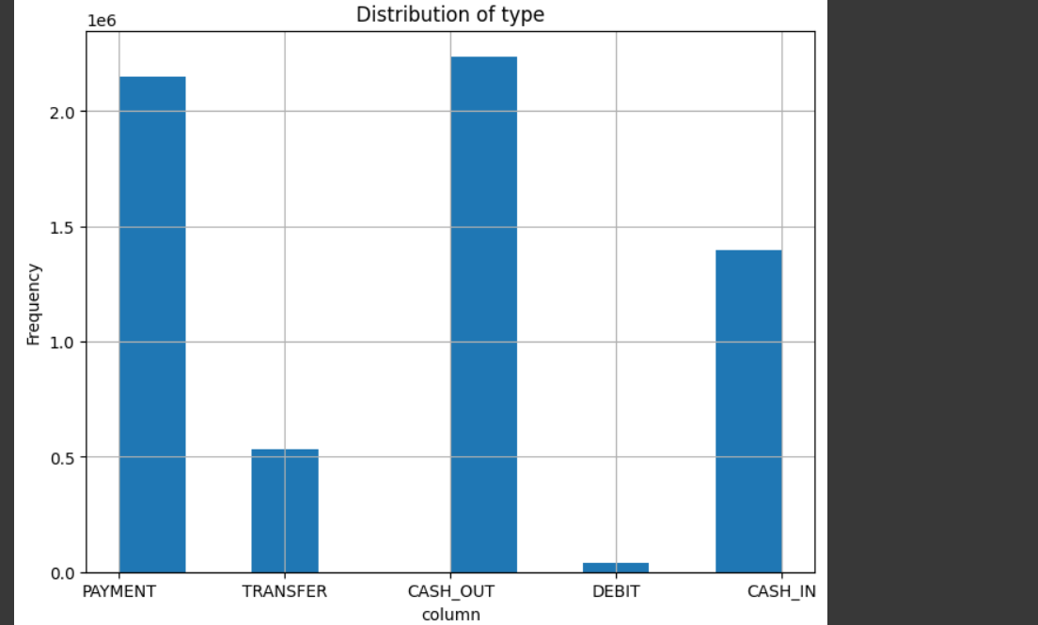
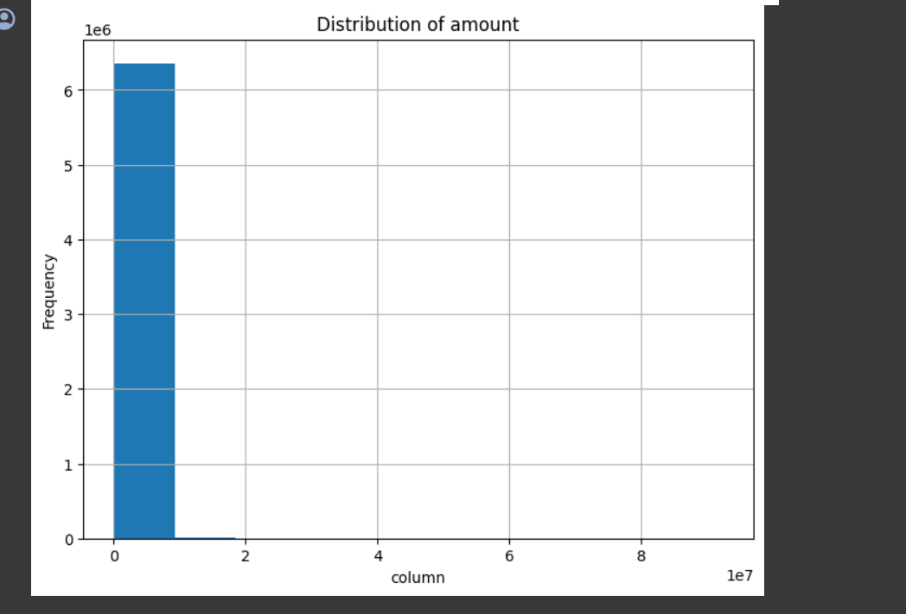

Slide 22
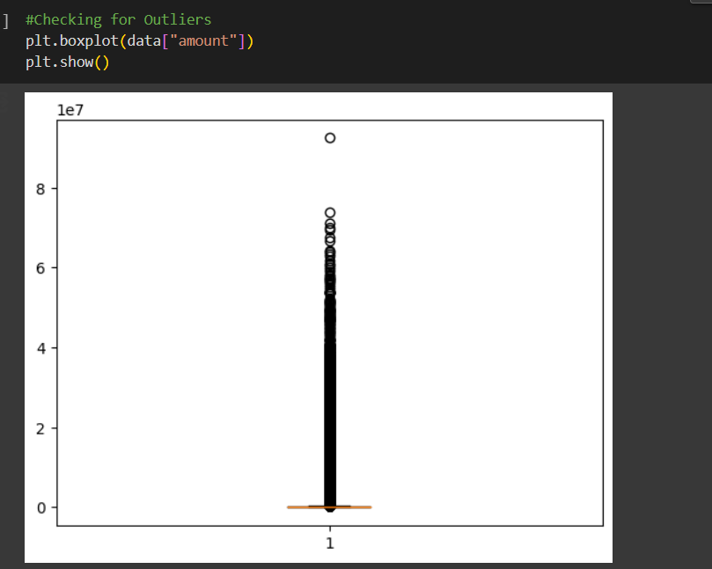
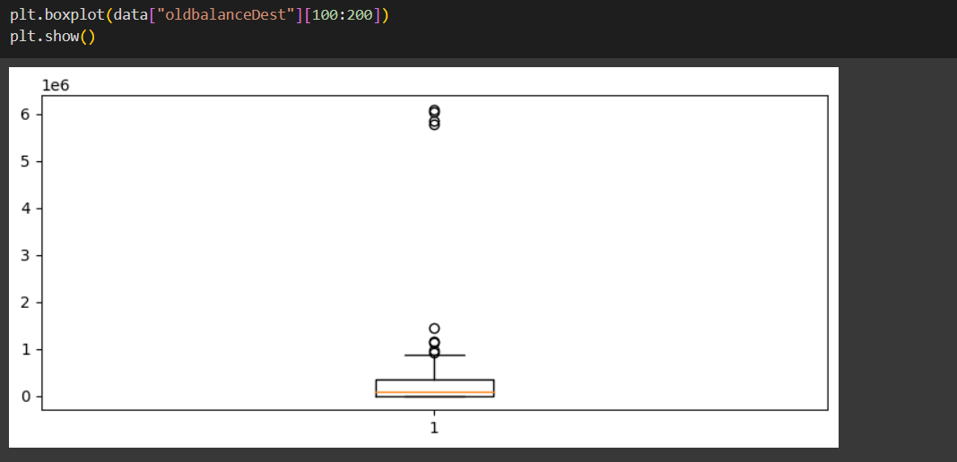

Slide 23
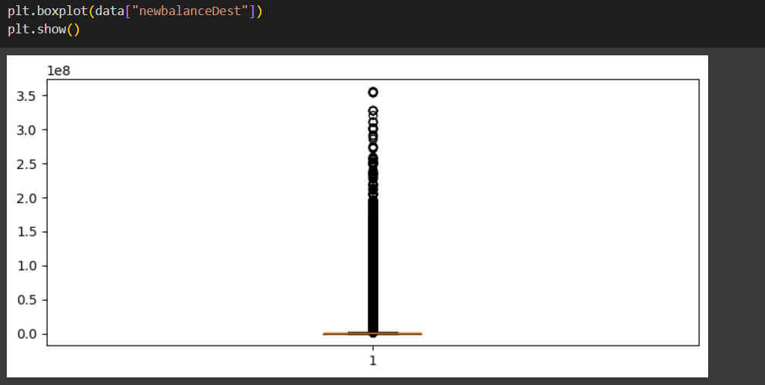

Slide 24
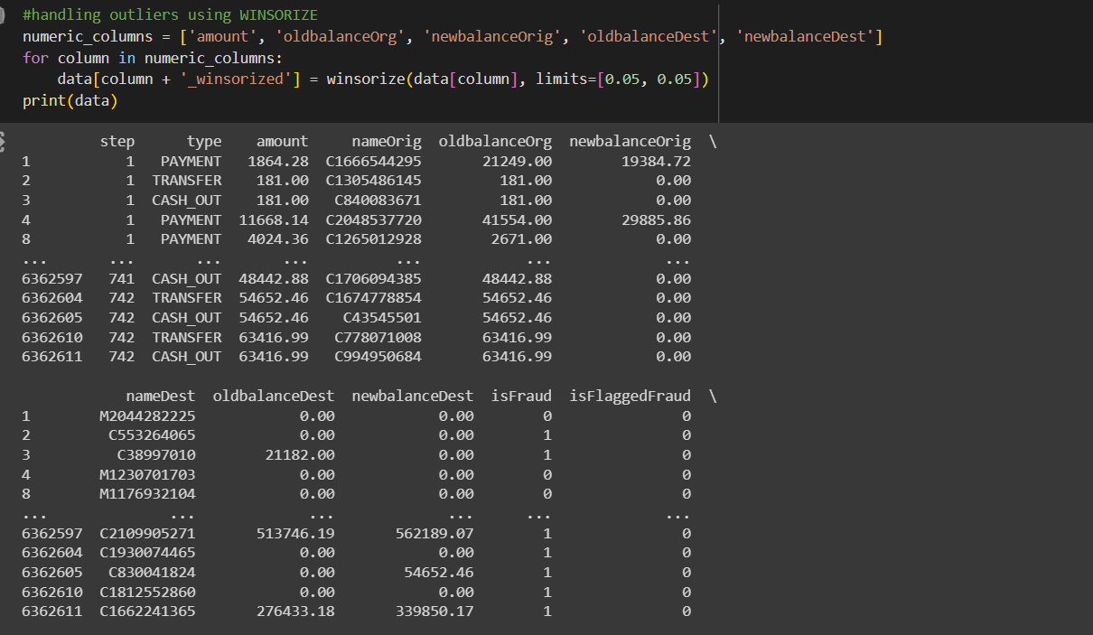

Slide 25
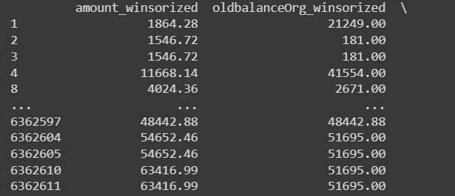
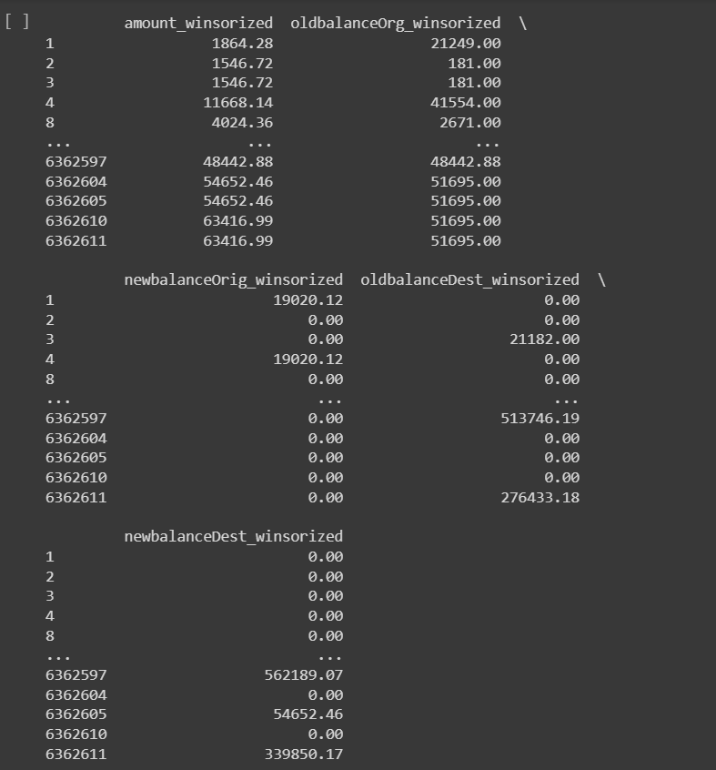

Slide 26
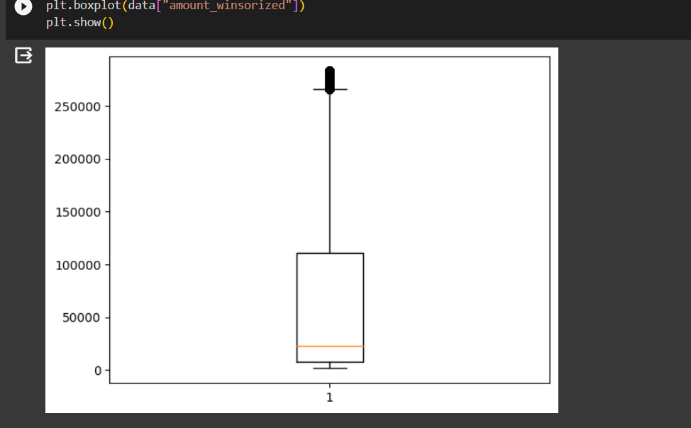
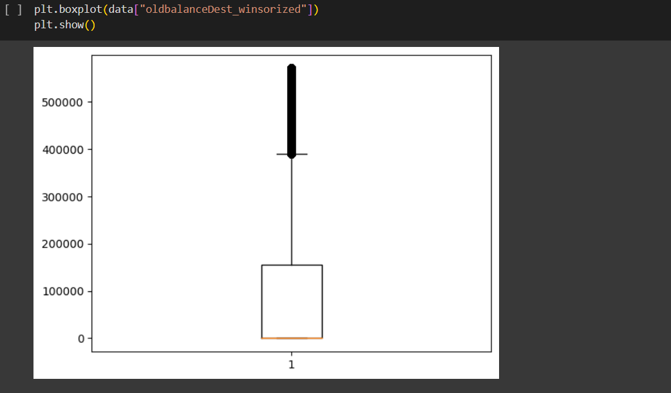

Slide 27
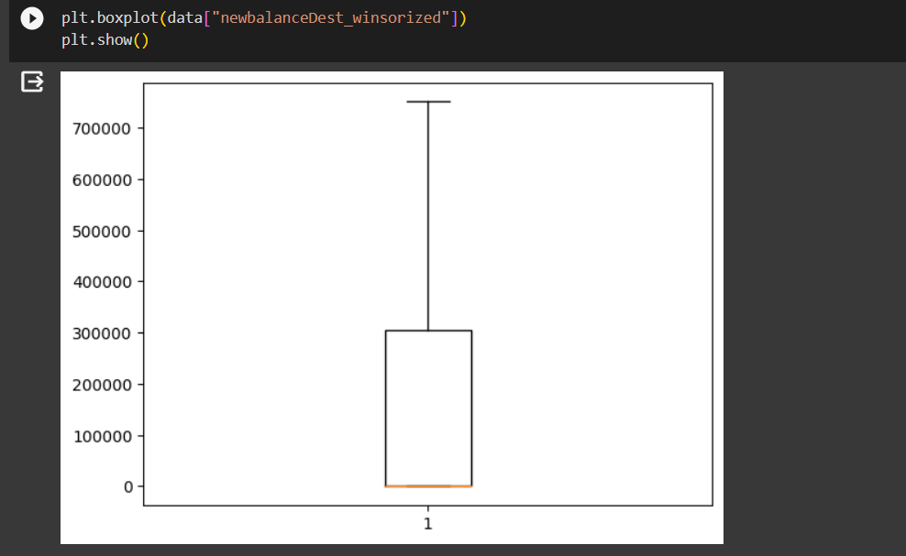
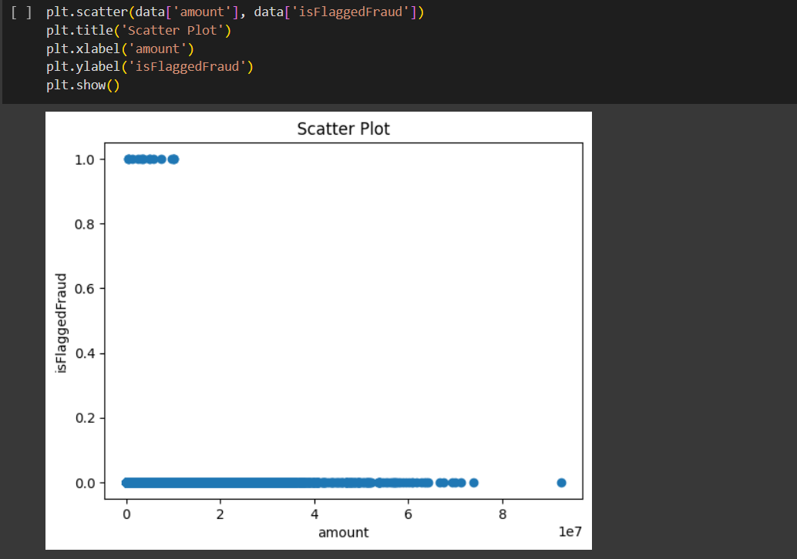

Slide 28
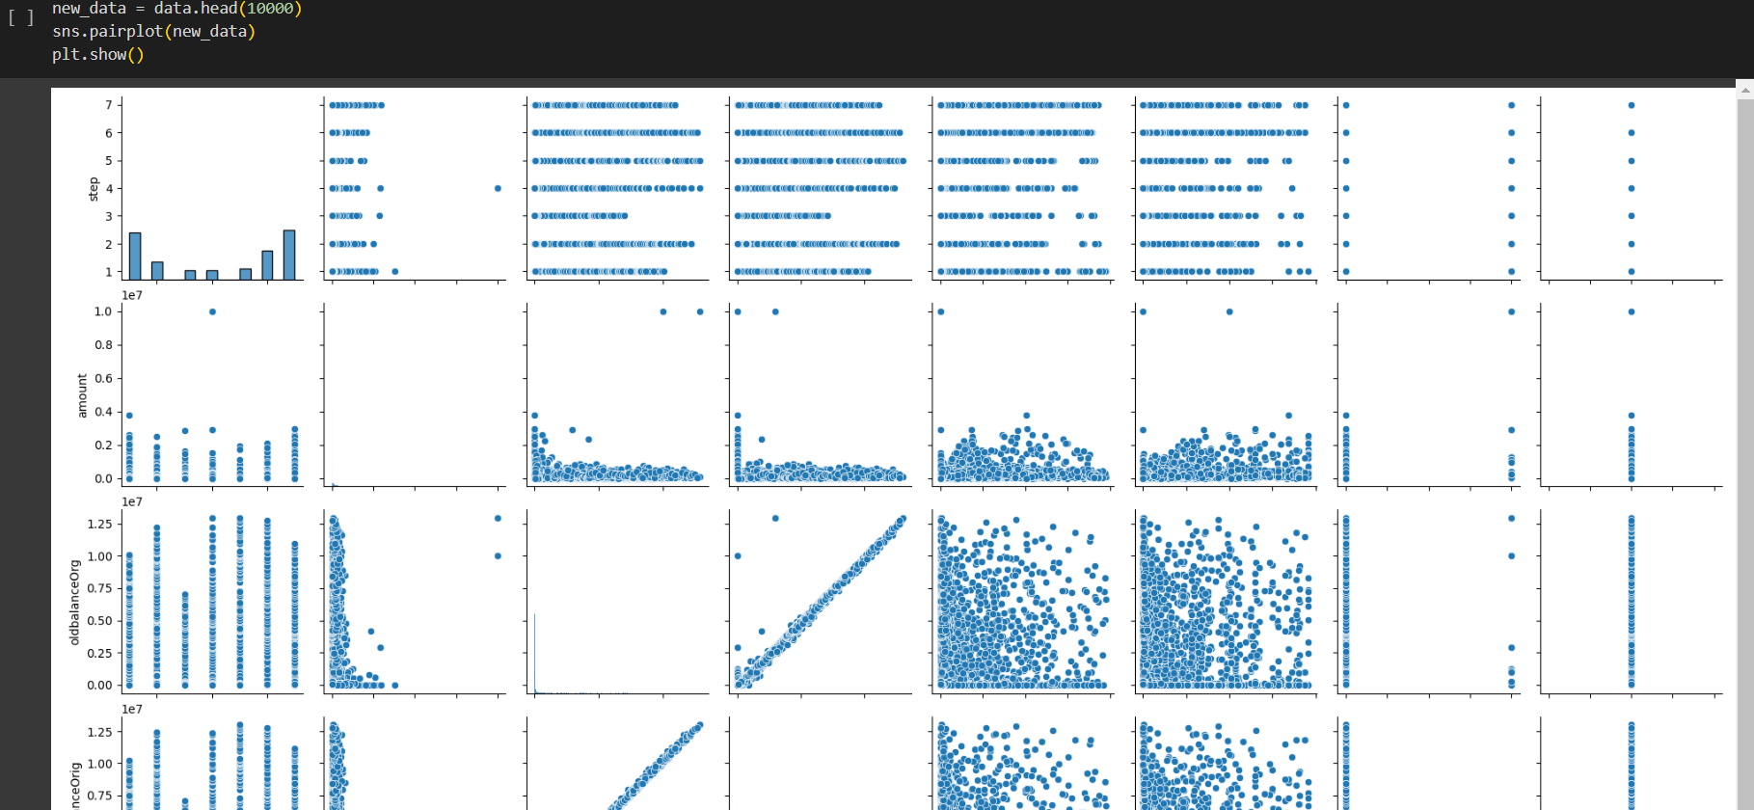

Slide 29
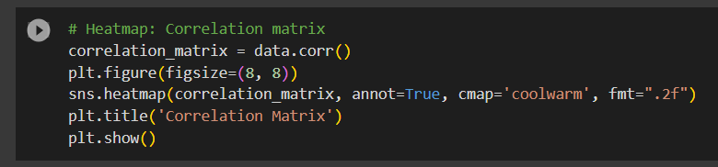

Slide 30
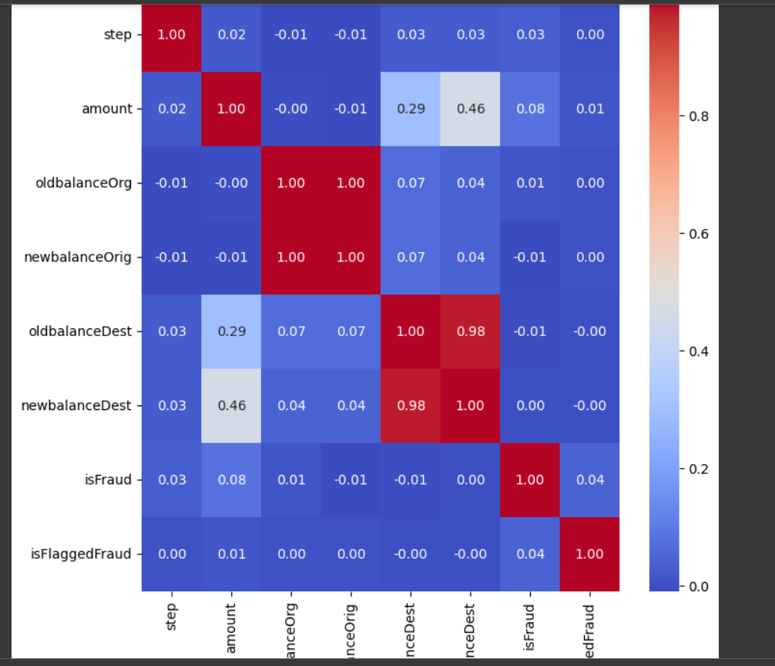

Slide 31
NEXT STEP OF RESEARCH FOCUS
Data Splitting
Model Selection
Model Training
Predicition
Result Interpretation

Slide 32
CONCLUSION
In summary, Walmart's adoption of a strong fraud detection system has shown to be a vital and successful step in protecting the business's financial integrity and guaranteeing a safe environment for stakeholders and customers to purchase. Walmart has achieved more accuracy and efficiency in detecting and preventing fraudulent actions by utilizing cutting-edge technology like artificial intelligence, data analytics, and machine learning.
The fraud detection system has proven to be able to spot unusual trends and abnormalities in transactions, and it has also changed over time to accommodate increasingly complex and sophisticated fraud schemes. This flexibility is essential in the ever-changing world of fraud, where dishonest people are always looking for new and creative methods to take advantage of weaknesses.In summary, Walmart's adoption of a strong fraud detection system has shown to be a vital and successful step in protecting the business's financial integrity and guaranteeing a safe environment for stakeholders and customers to purchase. Walmart has achieved more accuracy and efficiency in detecting and preventing fraudulent actions by utilizing cutting-edge technology like artificial intelligence, data analytics, and machine learning.

Slide 33
REFERENCES
R. Bajaj et al., "WALTS: Walmart AutoML Libraries, Tools and Services," 2022 48th Euromicro Conference on Software Engineering and Advanced Applications (SEAA), Gran Canaria, Spain, 2022, pp. 21-28, doi: 10.1109/SEAA56994.2022.00013.
M. V. Ramasami, R. Thangaraj, S. Manoj Kumar and S. Eswaran, "Exploratory Data Analysis of Walmart Outlets Sales using Data Analytics Techniques," 2023 International Conference on Digital Applications, Transformation & Economy (ICDATE), Miri, Sarawak, Malaysia, 2023, pp. 1-4, doi: 10.1109/ICDATE58146.2023.10248586.
S. B. Latha, C. Dastagiraiah, A. Kiran, S. Asif, D. Elangovan and P. C. S. Reddy, "An Adaptive Machine Learning model for Walmart sales prediction," 2023 International Conference on Circuit Power and Computing Technologies (ICCPCT), Kollam, India, 2023, pp. 988-992, doi: 10.1109/ICCPCT58313.2023.10245029.
Z. Qiao, "Walmart Sale Forecasting Model Based On LightGBM," 2020 2nd International Conference on Machine Learning, Big Data and Business Intelligence (MLBDBI), Taiyuan, China, 2020, pp. 76-79, doi: 10.1109/MLBDBI51377.2020.00020
V. Jain, H. Kavitha and S. Mohana Kumar, "Walmart Credit Card Fraud Analytics," 2022 IEEE International Conference on Data Science and Information System (ICDSIS), Hassan, India, 2022, pp. 1-5, doi: 10.1109/ICDSIS55133.2022.9915901.
C. G. Tekkali and K. Natarajan, "synthetic Financial Datasets For Fraud Detection," 2023 Third International Conference on Artificial Intelligence and Smart Energy (ICAIS), Coimbatore, India, 2023, pp. 523-526, doi: 10.1109/ICAIS56108.2023.10073712.

Slide 34
A. Mahajan, V. S. Baghel and R. Jayaraman, "Walmart Credit Card Fraud Detection," 2023 10th International Conference on Computing for Sustainable Global Development (INDIACom), New Delhi, India, 2023, pp. 339-342.
T. Zhang and S. Gao, "Fraud Detection," 2022 4th International Conference on Intelligent Information Processing (IIP), Guangzhou, China, 2022, pp. 272-275, doi: 10.1109/IIP57348.2022.00063.
Z. Chen, M. Cai and Z. Wang, "Online Payments Fraud Detection," 2022 IEEE 4th International Conference on Power, Intelligent Computing and Systems (ICPICS), Shenyang, China, 2022, pp. 36-40, doi: 10.1109/ICPICS55264.2022.9873622.
A. Namiranian and M. R. Hashemi, "A. Namiranian and M. R. Hashemi, "A new DCT based scalable distributed fraud detection architecture," 6th International Symposium on Telecommunications (IST), Tehran, Iran, 2012, pp. 1076-1081, doi: 10.1109/ISTEL.2012.6483146.," 6th International Symposium on Telecommunications (IST), Tehran, Iran, 2012, pp. 1076-1081, doi: 10.1109/ISTEL.2012.6483146.

